Slide 1
Describing Distributions

Slide 2
Lesson Objectives
Review ways of visualizing probability distributions
Review terms for describing distributions

Slide 3
Let’s collect some data
You will have one minute to make a paperclip chain.
When you’re done, I’ll tell you what we’re going to do with it 🙂

Slide 4
How would you describe the shape of our graph?

Slide 5
Describing distributions
Helpful Words
Helpful Numbers
Uniform
Bell-shaped
Symmetric
Skewed
Bimodal
Multimodal
Mean
Median
Mode
Range
Inter-Quartile Range (IQR)

Slide 6
Distributions: Uniform vs Bell-Shaped
Values tend to cluster around a central value
Uniform
Bell-Shaped
All values about equally common
Values get less common as you get further from the center

Slide 7
Distributions: Symmetric vs Skewed
Symmetric
Skewed
This value is my axis of symmetry
Same distribution on each side of the axis
There’s nowhere I can draw an axis of symmetry for this distribution!

Slide 8
Is this distribution skewed-left or skewed-right?
It’s skewed ...
right
(... did you get it right?)
Why do you think we say it’s “skewed-right” even when all the bars are on the left side of the screen?

Slide 9
To turn this into a skewed-right distribution ...
We take some of the data left of the center ...
... and move it to the right side

Slide 10
Skew is relative to the center of the distribution
Here’s where the center would be, if this were a symmetric bell curve!
We call this area the head of the distribution.
Most of the distribution appears to the right of that center bar.
We call this the tail.
Thus, we say this distribution is skewed right.
The tail is to the right.

Slide 11
Distributions: Unimodal vs Bimodal
Unimodal
Bimodal
One cluster ...
... Two clusters!

Slide 12
bi·mod·al
(Makes this word an adjective)
“Two”
“Mode”
“Having two modes.”
(But wait, how can a distribution have two modes?)

Slide 13
Finding the mode from a graph
Remember, the mode is the value that occurred most often
What’s the mode of this distribution?
The height of each bar tells us how often that value occurred ...
... so to find the mode, we just look for the tallest bar!
The mode of this graph is 65!

Slide 14
Does this bimodal graph really have “two modes?”
Well, there are two clusters ...
and each of them has a mode!

Slide 15
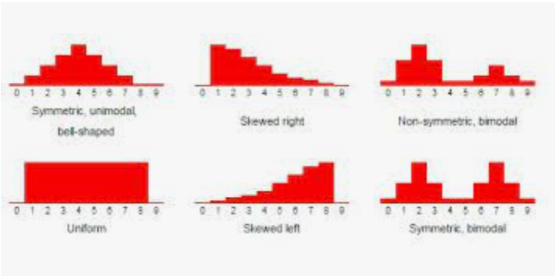
How would you describe the shape of our dot plot?
Symmetrical?
Uniform?
Unimodal?
Bimodal?
Skewed? Left or right?

Slide 16
Homework
See Teams for a short assignment based on what we talked about today

